Slide 1
Sugar syrup and supplementary feeding trials to improve pollination efficiency
Dr Madlen Kratz
Honeybee Industry Development Officer
madlen.kratz@dpi.nsw.gov.au

Slide 2
“The only way to stay in business in the long run is to adapt and change management practices as the circumstances dictate.”
Quoted from:
Fat bees – skinny bees a manual on honey bee nutrition for beekeepers by Dr Doug Somerville

Slide 3
Nothing stays the same!
Mite: Varroa destructor

Slide 4
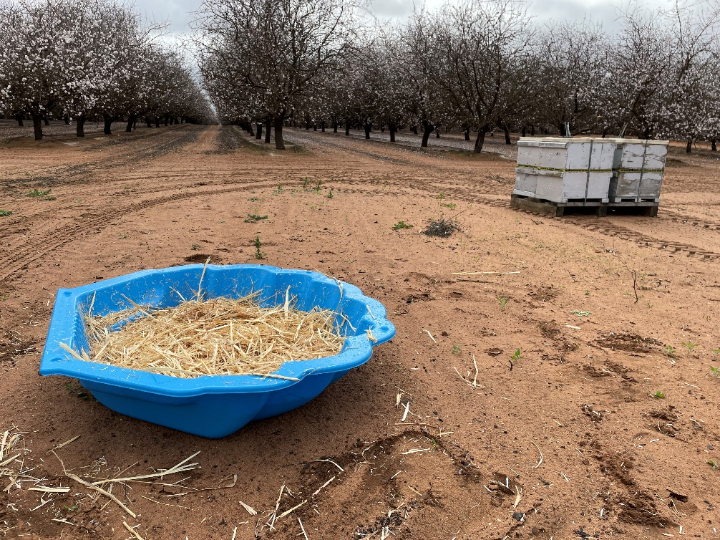
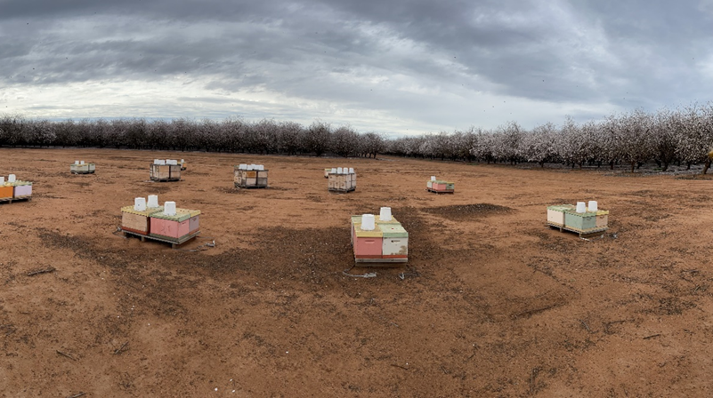
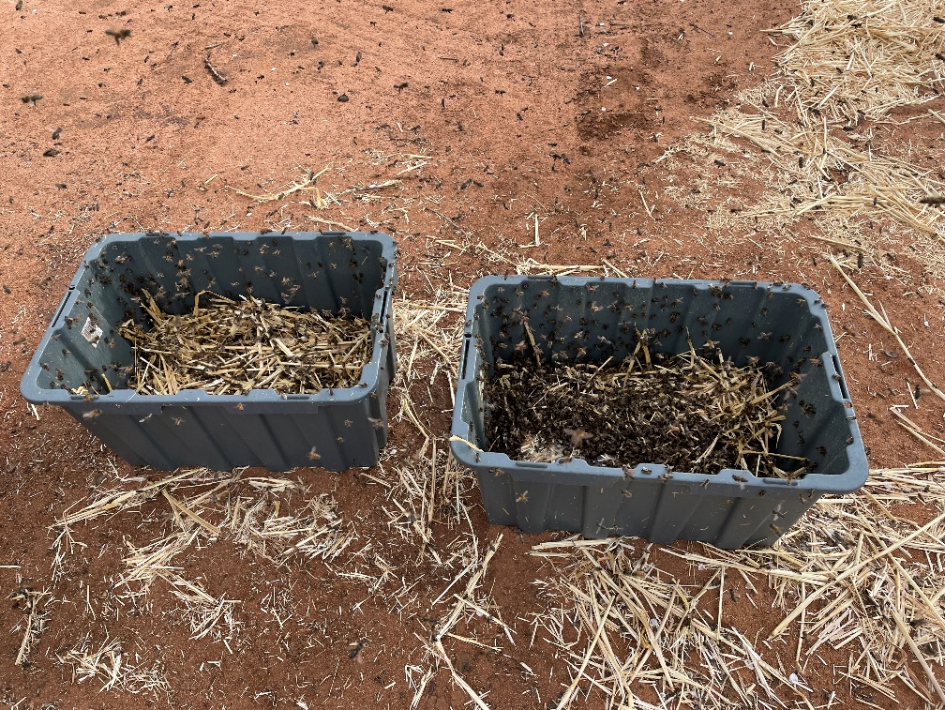
Sugar syrup feeding
Open fed
In-hive

Slide 5
What does sugar syrup feeding do?

Slide 6
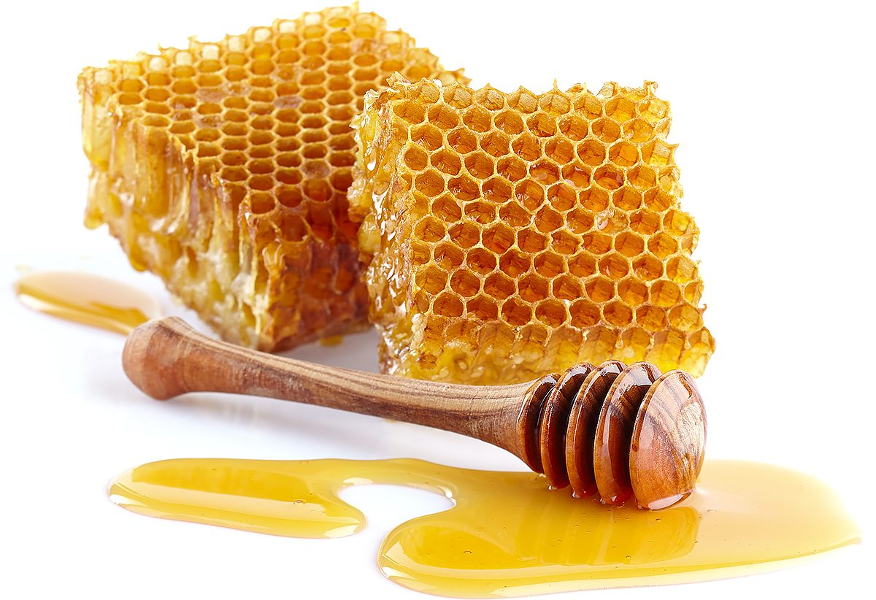
Source of carbohydrates

Slide 7
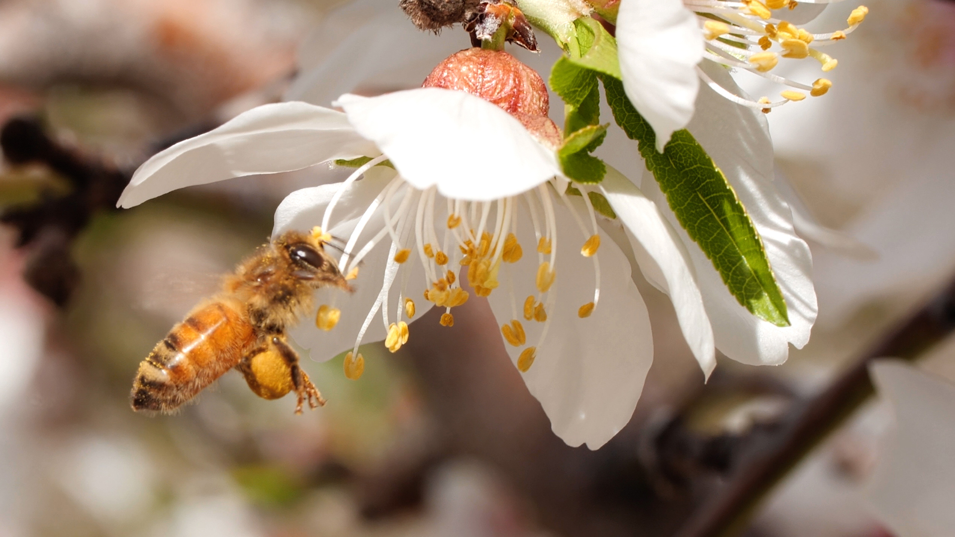
Sugar syrup stimulates pollen collection!

Slide 8
Bees need to have a reason to collect pollen!
Challenge: Cold environment, lack of resources

Slide 9
Credit: Randy Oliver

Slide 10
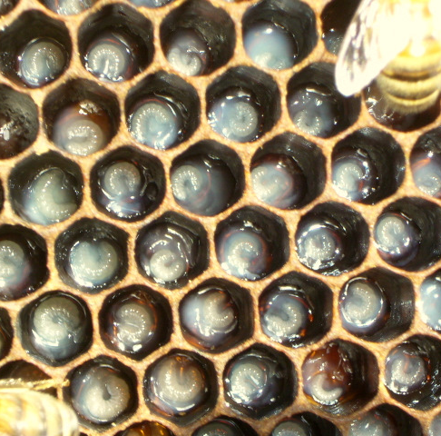
Nectar stimulates the colony
Queen starts laying eggs
Gland development for brood food production in nurse bees
Colony increases foraging flights to collect pollen
Hungry larvae = Biggest pollen need!
Pollen:
Protein, Fats, minerals, vitamins
Credit: Randy Oliver

Slide 11
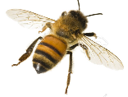
Almond flowers are poor in nectar

Slide 12
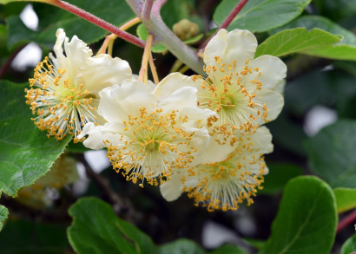
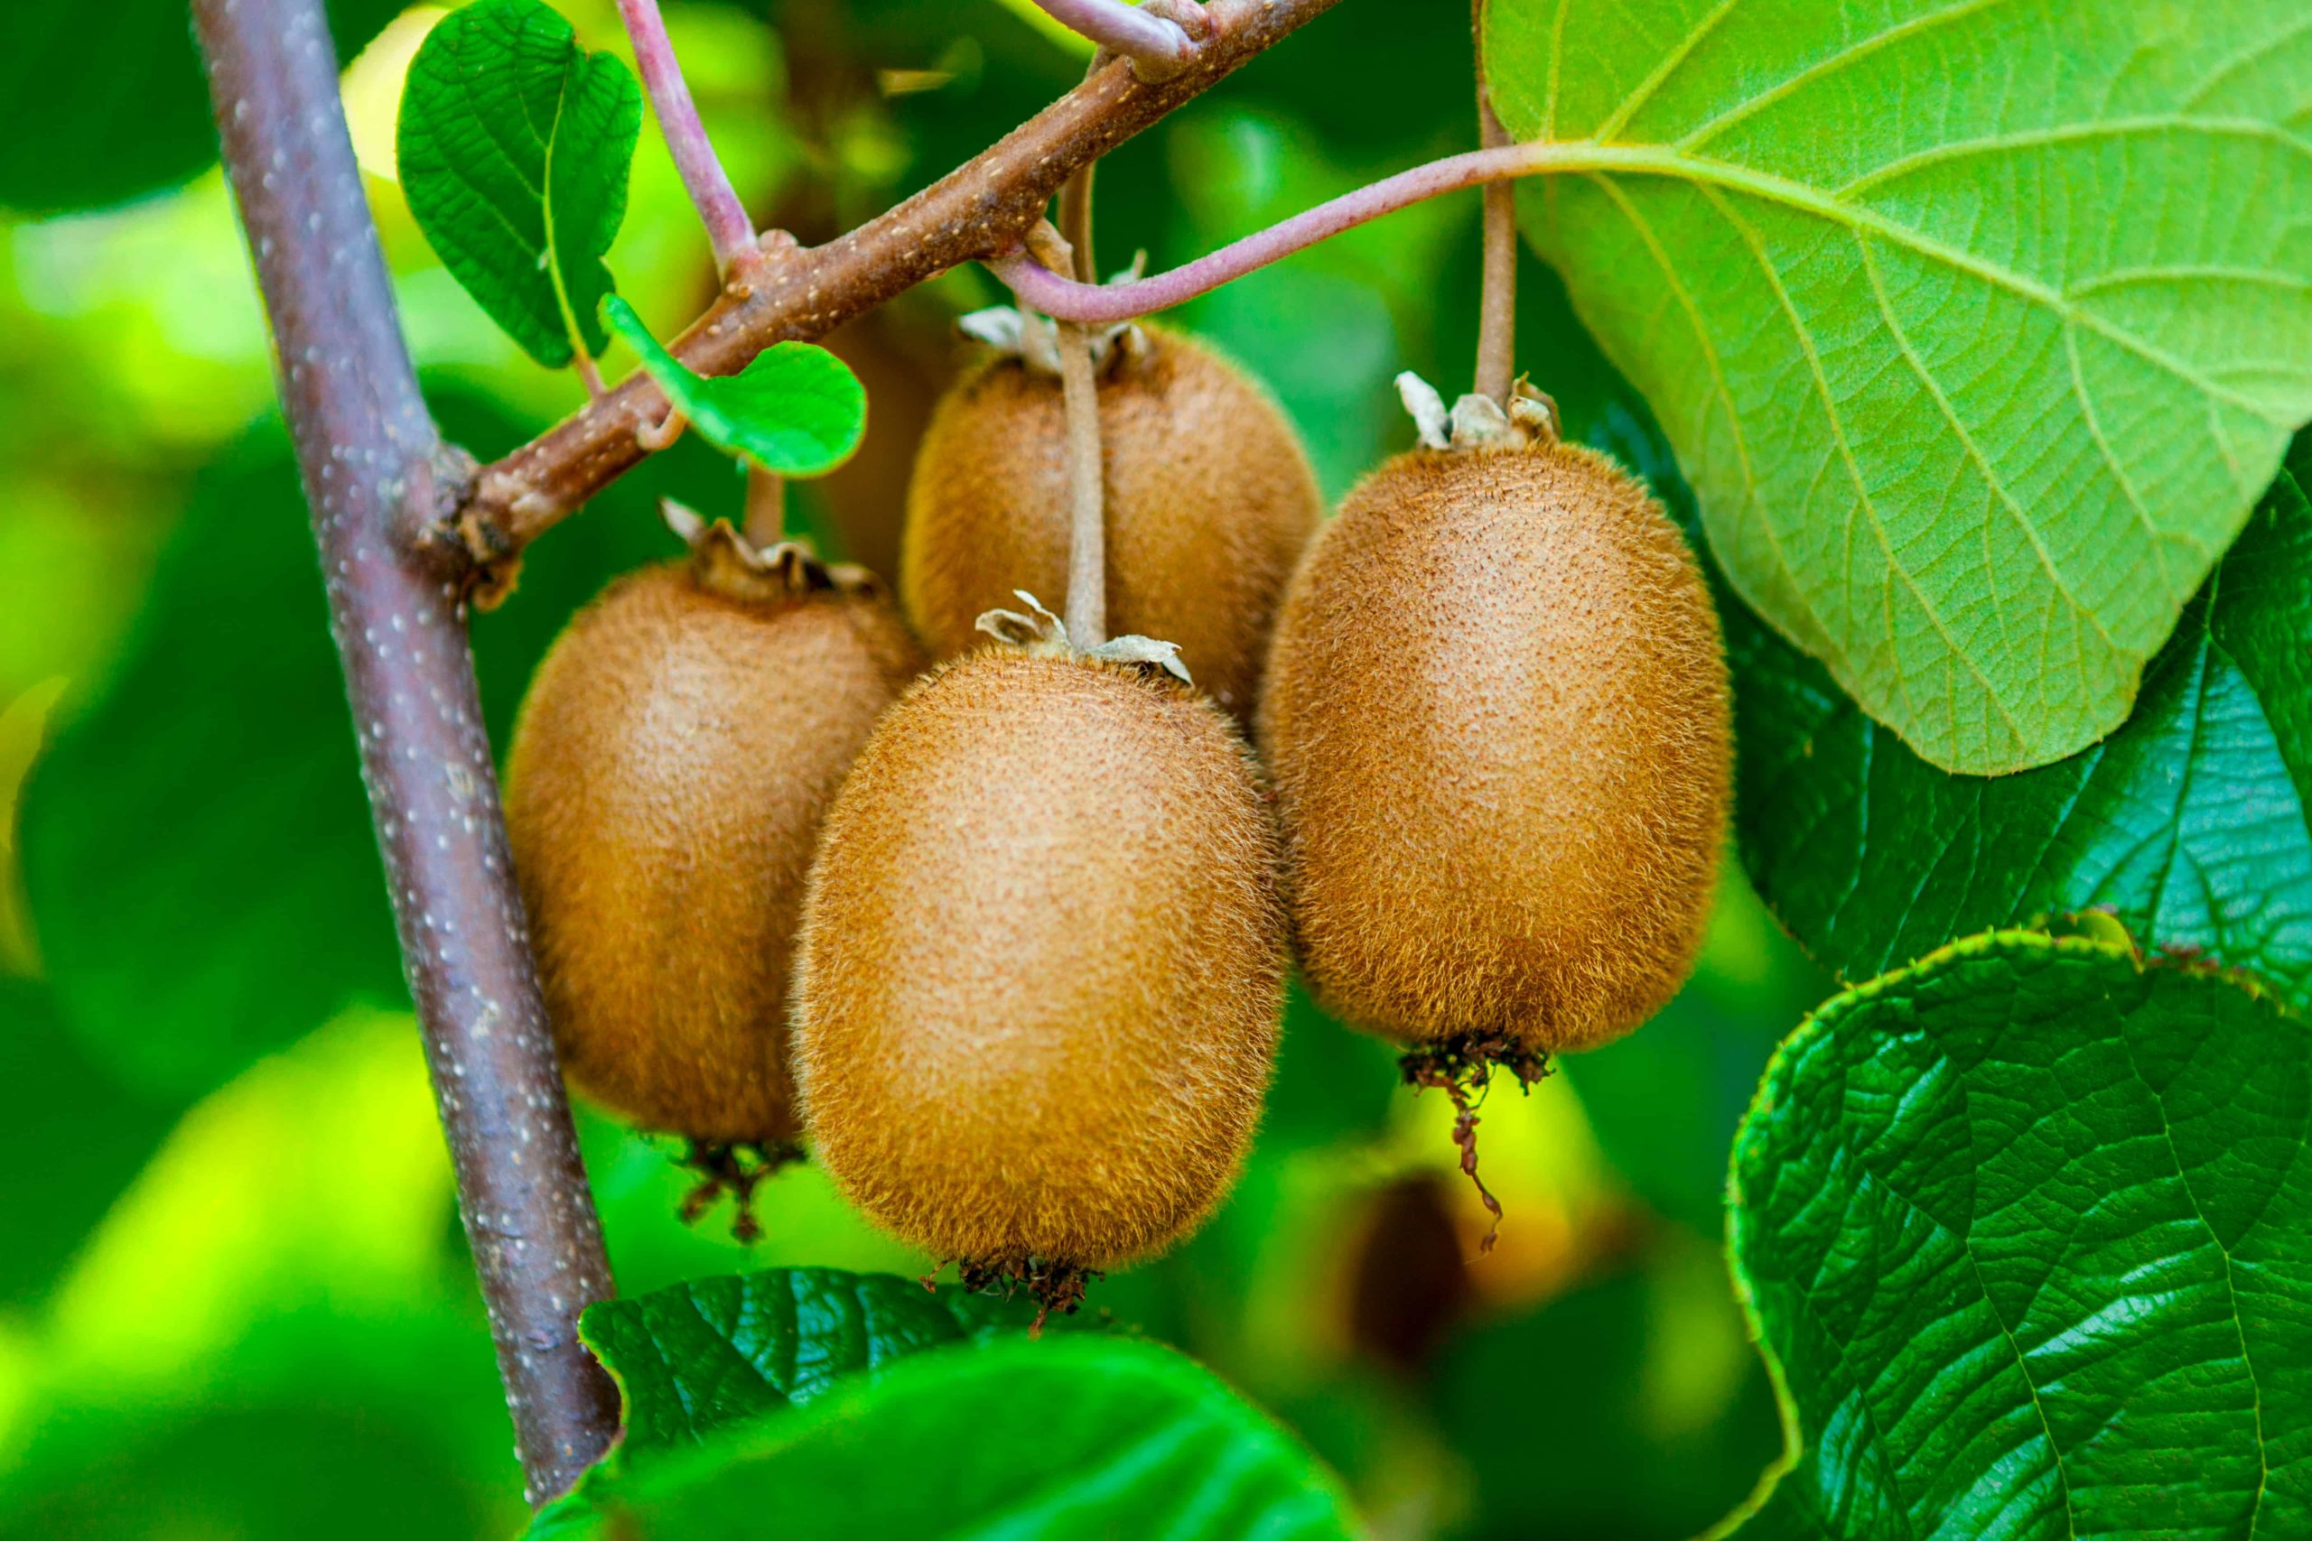
Kiwi fruit pollination
‘Feeding sugar syrup to honey bee colonies inside their hives doubled their collection of kiwifruit pollen in trials during the 1984 flowering season.’ - Goodwin

Slide 13
To consider
What does the crop provide
What other floral sources are available in the environment that could be beneficial to bees? – When do they flower? (beginning, middle or end of pollination period)
Potential impact of varroa on preparing hives for pollination
Cover crops
Beekeeper and grower concerns and challenges!

Slide 14
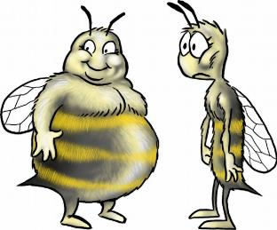
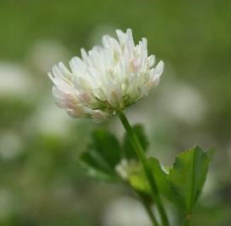
Current research projects
Costs and benefits of supplementary feeding
2. Clover4Bees

Slide 15
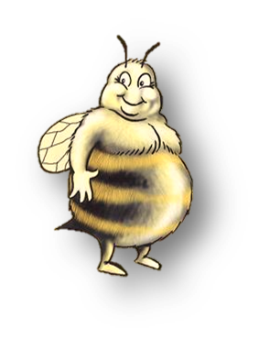
Aims of the project
How much to feed (quantity)
How often (frequency)
At what concentrations
Costs vs benefits

Slide 16
Supplementary feeding as a tool
N -Fixation

Slide 17
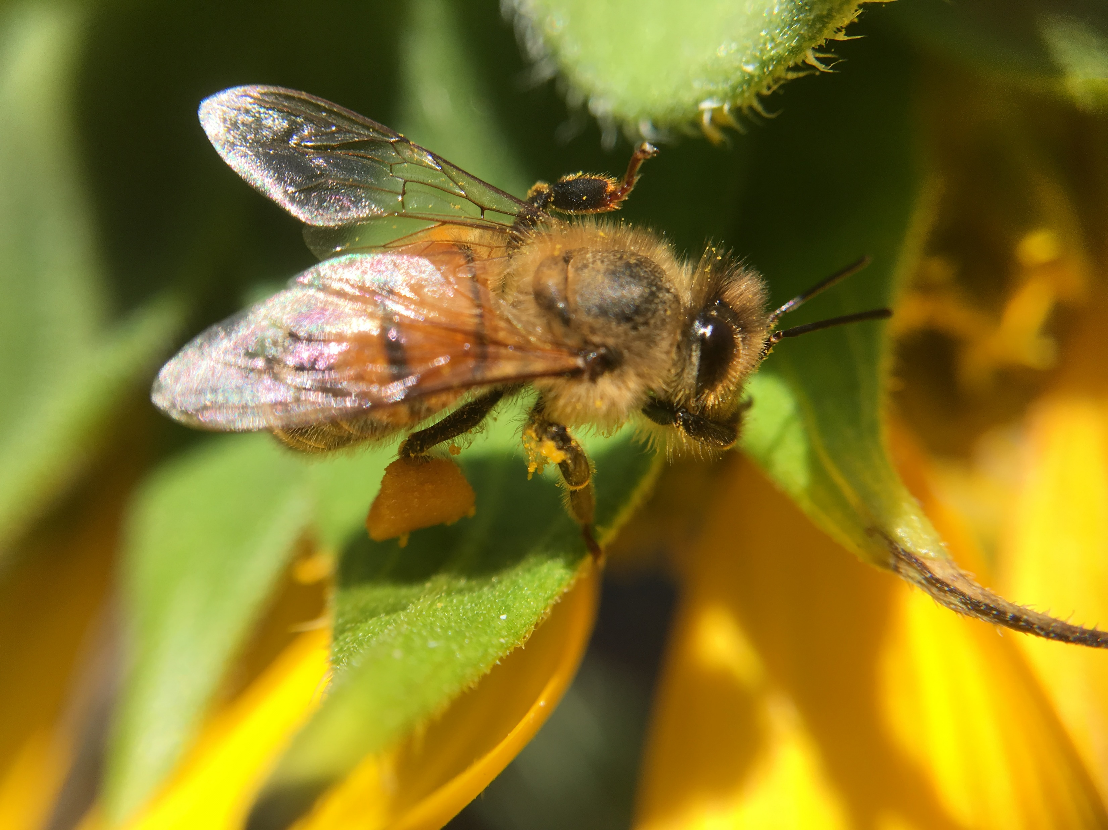
Dr Madlen Kratz
E-mail: madlen.kratz@dpi.nsw.gov.au

Slide 18
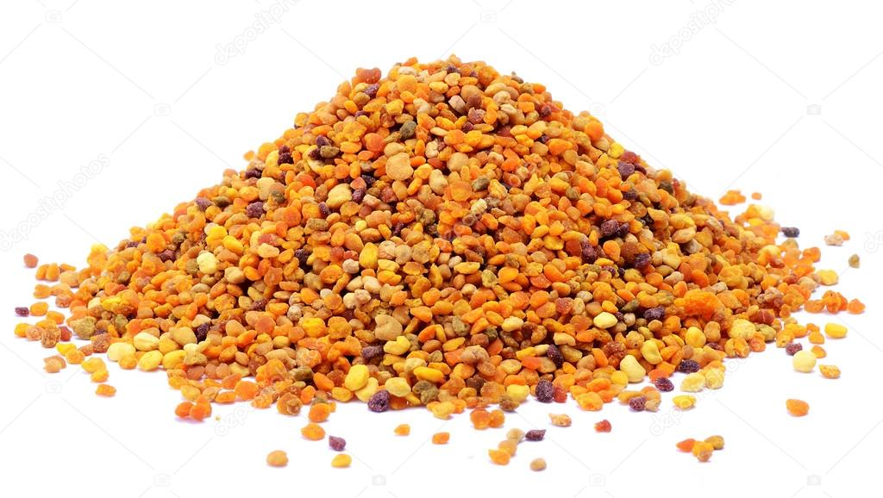
Varroa and honey bee nutrition
Adult bees parasitized during development show:
- Suppressed immunity
Increased susceptibility to various pathogens
Reduced longevity
“While good nutrition may not reduce virus levels, it can improve bees’ tolerance and resilience to viral infections (Dolezal et al. 2019)”
Healthier bees = stronger colonies = greater pollination capacity!
Notes:
Brood production, longevity, immunity
Good quality and quantity of pollen
Positive effect on immunity
Improves bee longevity of adult workers parasitized by varroa as pupae
An example of how nutrtion benefits overall health of the colony
One way to mnage mite levels is through enforcing a broodless period which in cooler climates happens naturally, and supplementary feeding will then become important to stimulate and grow colonies especially for winter crops such as for almonds!

